Slide 1


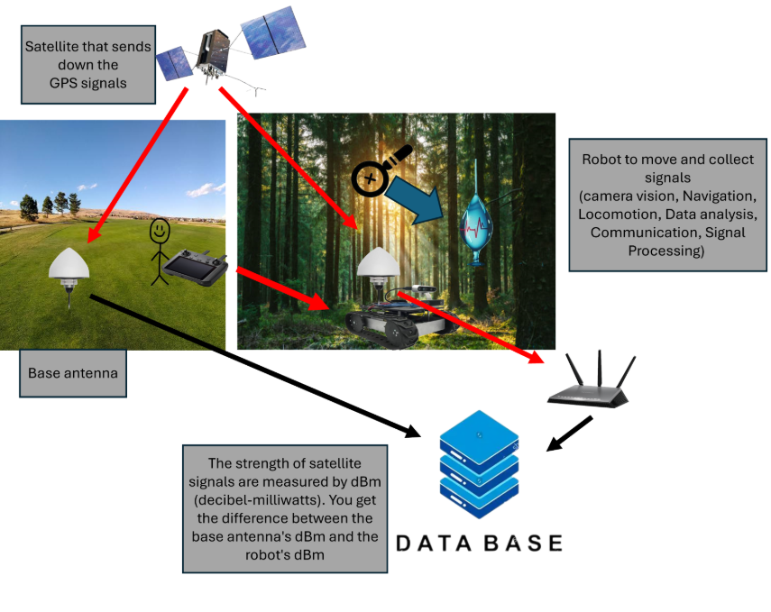
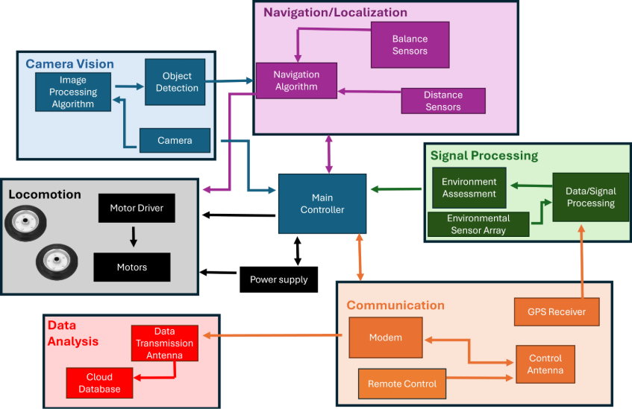
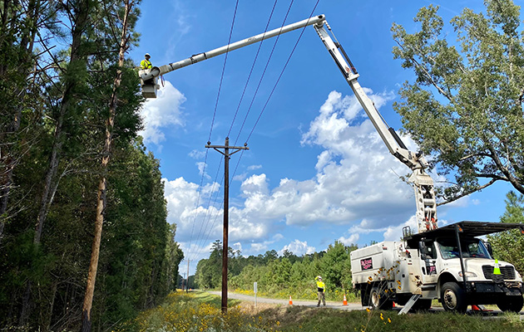
Forest Buddy
John Allen (Project Manager), Joshua McGee (Chief Scientist),
Landon Garrett (CPE), Gerardo Hernandez (EE), Alten Reeves (EE), Lane Williams (EE)
Department of Electrical and Computer Engineering
Mississippi State University
Problem and Target User
Solution
Broader Impact
Official MSU Colors
Many forests in the United States are at risk from Drought
Nearly 11% of forestry is exposed to drought, expected to rise to 38% by mid-century [1].
Benefits for target user
Forestry agencies and land managers benefit as the Forest Buddy cuts labor and time costs of inspecting large quantity of trees.
Non destructive: requires no trees to be harmed.
The sensing will catch disease early enough to prevent death of trees.
Potential impacts in other fields
The Forest Buddy could help the power industry by detect weak or dying trees near powerlines.
It could also help with fighting wildfires as canopy moisture data could be used for regional fire risk models.
In addition, it could be used in agriculture in irrigation systems as the moisture data feeding can help with irrigation stress detection.
Unlikely Byproducts
The robot's sensing and mobility chassis could be used to collect data of trees after a natural disaster showing standing tree population and fallen trees aiding clean up.
The sensing and mobility chassis can also be changed to get data of soil moisture and invasive plant species.
Diseases affect millions of acres of forested land in the US.
11-16% of tree species are threatened by extinction due to pest and diseases [2].
Previous Solutions
Leaf Link
Used a pulley system.
Extremely limited mobility.
Manual inspection
Economical, but impractical for inspecting large areas, and often too late to detect diseases [3][4].
Lab testing
Fast and effective, but requires the tree to be cut, which harms the tree [3][4].
System Diagram
0.5” Square that can be used for measuring margins and spacing
Competitive Advantages
References
Catches disease earlier than manual methods.
More time efficient.
Inexpensive.
≤ $1000
Data collection is non-destructive.
Scalable.
[1] “Forests and a future of drought: Area exposed to severe drought projected to triple by 2070 | US Forest Service Research and Development,” US Forest Service Research and Development, 2026. https://research.fs.usda.gov/srs/articles/forests-and-future-drought-area-exposed-severe-drought-projected-triple-2070 (accessed Sept. 03, 2026).
[2] “Researchers complete first comprehensive threat assessment of all U.S. trees,” United States Botanic Garden, Aug. 23, 2022. https://www.usbg.gov/blog/researchers-complete-first-comprehensive-threat-assessment-all-us-trees (accessed Sept. 08, 2026).
[3] M. Li, H. Li, X. Ding, L. Wang, X. Wang, and F. Chen, "The detection of pine wilt disease: A literature review," Int. J. Mol. Sci., vol. 23, no. 18, p. 10797, Sep. 2022, doi: 10.3390/ijms231810797.
[4] S. Tahir, S. S. Hassan, L. Yang, M. Ma, and C. Li, "Detection methods for pine wilt disease: A comprehensive review," Plants, vol. 13, no. 20, p. 2876, Oct. 2024, doi: 10.3390/plants13202876.

